Slide 1


Internet of Your Things
with
Microsoft Azure
Patrick Shim
Global Black Belt TSP / Azure IoT

Slide 2
Agenda
09:00 | 11:00 | Module 1: Introduction to Azure IoT
11:00 | 11:15 | Break
11:15 | 12:00 | Module 2: Azure IoT and NODE-RED (demo)
12:00 | 13:00 | Lunch
13:00 | 14:00 | Module 3: Azure IoT Suite – Remote Monitoring
14:00 | 15:00 | Module 4: Data Management with Azure Data Factory
15:00 | 15:30 | Break and Hands on Lab Setup
15:00 | 17:30 | Module 5: Hands on Lab

Slide 3
IoT 2010
Alarm clock
Refrigerator
Automobile
VoIP phone
Computer
Printer
Media player
Microwave
HOME
WORKPLACE
HOME
Coffee maker
Smart scale
Oven
Cell phone
HVAC
Vending
Security
Television
Notes:
This has happened quickly
We had early generations of smart cars, smart refrigerators and smart WiFi scales
However, devices were isolated, stand alone and typically had their own exclusive ecosystem
Devices were typically expensive, or only certain models

Slide 4
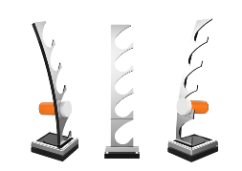
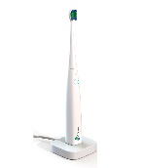
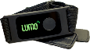
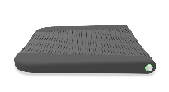
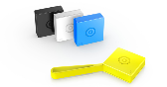
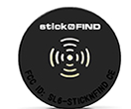


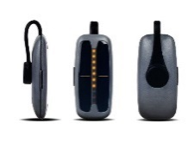
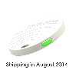
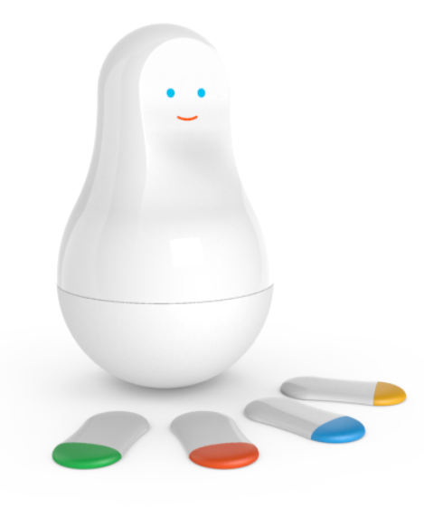
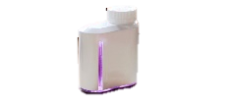

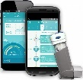
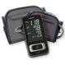
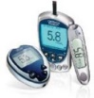
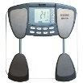
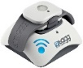
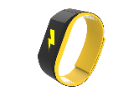
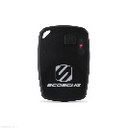

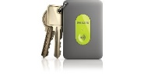
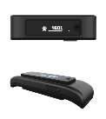

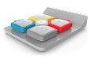
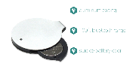
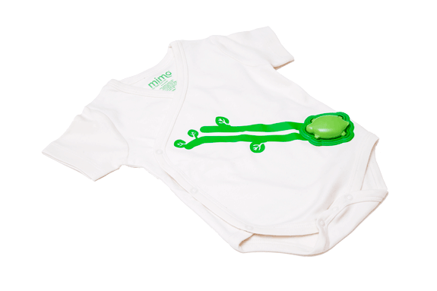
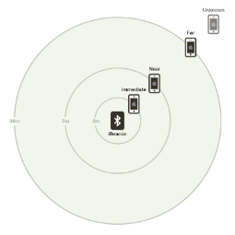
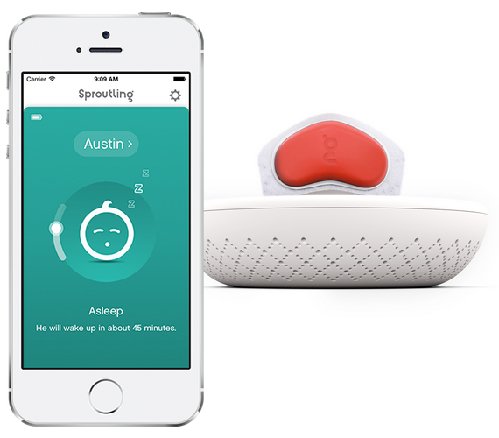

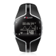
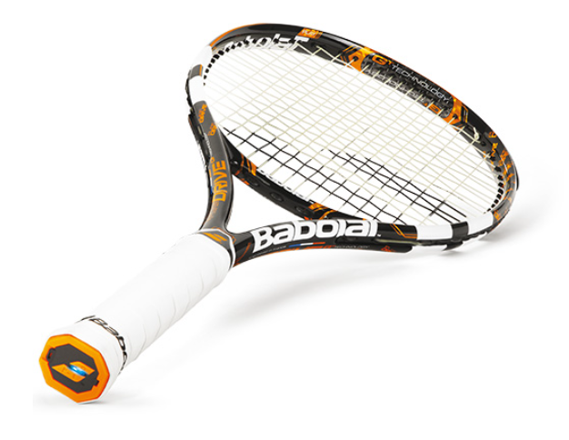
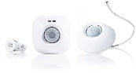
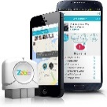
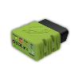
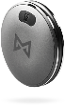
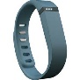
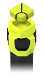
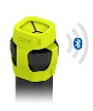
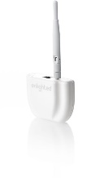
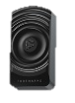
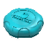
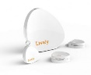
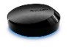
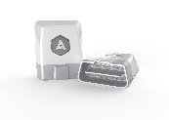
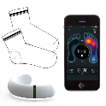
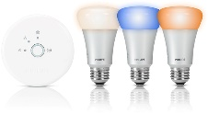
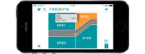
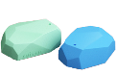
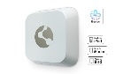
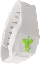
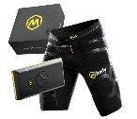
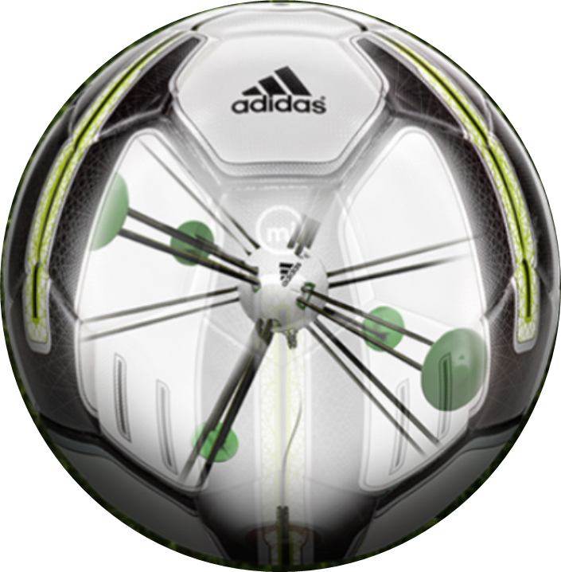


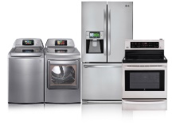
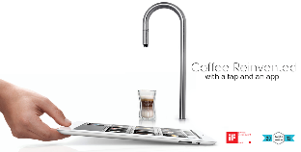
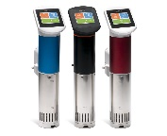













































IoT 2016
Medication adherence
Health monitoring
Pet tracking
Behavior modification
Object tracking
Child and elder monitoring
Sports and fitness
Indoor navigation
Trip tracking and car health
Smart lighting
Beacons and proximity
COMMUTE
COMMUTE
HOME
WORKPLACE
HOME
Smart appliances
Food and nutrition tracking
Identity
Office equipment
Smart vending machines
Bike ride stats and protection
Air conditioning and temperature control
Sleep tracking
Environmental sensors
Information capture
Control
Home security
Home automation
Leak detection
Garden, lawn and plant care
New devices and sensors
Entertainment systems
Notes:
- Ecosystems are integrated. Customers expect their phone to work with their watch and their car and their coffee machine.
Boundary is blurring between ‘work’ & ‘play’… many devices have a dual purpose
There are many more devices at the smaller & cheaper end of the spectrum. Not unusual to have network connectivity in a device costing a few bucks.
The explosion of new smart hardware devices needs to be supported by a broad, hyperscale service back-end to allow the integration between hardware ecosystems.

Slide 5

25 BILLION Connected “things” will be in use by 2020
$7.2 TRILLION worldwide market for IoT solutions by 2020
IDC: Worldwide and Regional Internet of Things (IoT) 2014–2020 Forecast
Gartner
Notes:
Various estimates of market size and all of the large analyst firms are taking an active interest.
Discuss Gartner number
Over 3 connected things for every man, woman and child on earth
Discuss IDC number

Slide 6

Disruptive Forces
Moore’s Law
Metcalf‘s Law
Koomey’s Law
Transistors
Computations
per KWh
10,000,000,000
1.E+14
1,000,000,000
1.E+12
100,000,000
1.E+10
10,000,000
1.E+08
1,000,000
1.E+06
100,000
1.E+04
10,000
1.E+02
1,000
1.E+00
1970
1980
1990
2000
2010
1940
1975
2010
And more importantly:
what can you do by combining and analyzing signals from all of these IoT devices?
Notes:
None of these are Laws (like gravity) as much as rules of thumb.
Moore’s Law https://en.wikipedia.org/wiki/Moore%27s_law
The number of transistors in a dene integrated circuit (like a CPU but also other microprocessors and other things critical to IoT) roughly doubles every 2 years. Important to call out that both sides of the relationship; this is giving us not only faster smartphones. It also means that the cost of integrated circuits keeps being driven down… making things cheaper and cheaper
- i.e. After every two years, you can have twice the processing power for the same money, or you can have the same processing power for half the money.
Metclaf’s law https://en.wikipedia.org/wiki/Metcalfe%27s_law
The value of a telecommunications network is proportional to the square of the users. Connecting more things is very valuable and there are strong ‘network effects’. The best social network is the one that all of your friends also use, the best fitness tracker is the one on which you can compete with the most people. IoT is about connecting more and more things and in many cases more and more people.
Koomey’s Law https://en.wikipedia.org/wiki/Koomey%27s_law
Talks about the improving efficiency of computation. It’s related somewhat to Moore’s law. It talks about the number of Joules of energy per unit of computation. Energy efficiency is critical for the IoT because it allows more devices to be wireless and battery powered; indeed many IoT devices are wireless and disposable, running on a disposable battery for a period of time before being discarded.

Slide 7
IoT Business Maturity Model 1. Operational efficiency
Connect devices and monitor telemetry
Monitor and track device state, location and health
Things
Rules and alerting to improve operational efficiency
Notes:
Most customers adopting the IoT tend to follow a similar pattern.
- It starts with organizations hunting for operational efficiency.
- Subsequently they begin by connecting devices and capturing data. The cloud means that traditional concerns about ‘too much data’ are much less prevalent.
- Customers will be monitoring the IoT devices themselves and the things they they’re connected to.
Often customers will be using real time rules and alerting to make decisions in an ad hoc fashion about their things.

Slide 8
IoT Business Maturity Model 2. Business Intelligence
Analyze and visualize data from devices
Discover patterns in device data using predictive analytics
Things
Operationalize insights to improve things and processes in real time
Notes:
Next, organizations start to develop some business intelligence around the huge streams of data.
Once they’ve built a data set customers will start to derive insight from this. This moves from experimentation and exploration of data to insight, often using machine learning and other statistical and predictive models.
The cloud and predictive analytics work really well together. This is because predictive analytics requires a lot of computing power, which is ‘on tap’ in the cloud.
Insight allows customers to take better decisions as they run their business. Some of these will be real time operationalization of predictive models, some of these will be longer term strategic decisions.

Slide 9
IoT Business Maturity Model 3. Business Transformation
Combine IoT & other data with advanced analytics to power new services and revenue streams
Expand into new adjacent businesses
Things
New partnership opportunities
Notes:
Customers then integrate IoT into their broader business and explore new areas in which to deploy IoT solutions.
Data and devices in the field unlock new opportunities to partner with other organisations who’re also interested in the hardware platforms and data streams.
The cycle continues.

Slide 10

???

Slide 11
IoT Device and Cloud Patterns
Notes:
Get attendees hands on quickly to make it ‘real’
We’ve prepared lab content for attendees to use, so they can start working with the Azure IoT services (in a hands-on fashion) throughout the day.

Slide 12
Cloud Based IoT Solutions
Azure IoT
Easy to provision, use and manage
Pay as you go, scale as you need
Global reach, hyper scale
End to end security & privacy
Three parts of an IoT solution
1 | Device connectivity & management
2 | Analytics & operationalized insights
3 | Presentation & business connectivity
Notes:
A lot of businesses have been building IoT solutions with Azure, using a variety of Azure’s services over the years.
Why is Azure and the cloud so popular?
- Easy to provision, use and manage
- …
We see three key areas in an IoT solution:
- Device connectivity and management
- …

Slide 13






Azure IoT Reference Architecture
Devices and Data Sources
Data Transport
Device and Event Processing
Presentation
Cloud Gate-way
Data Visualization & Presentation
IP capable devices
Provisioning API
Solution Portal
Device State Store
Agent Libs
Identity & Registry Stores
{ }
Existing IoT devices
Stream Event Processor
Agent Libs
Gateway
Storage
Analytics/ Machine Learning
Low power devices
Agent Libs
Control System Worker Role

Slide 14
IoT Device & Cloud Patterns
Cloud Gateway
Event/IoT Hubs
Event Hubs
High scale telemetry ingestion service
HTTP/AMQP protocol support
Each Event Hub supports
1 million publishers
1GB/s ingress
Generally available worldwide
Tens of Billions of messages per day
Tens of TB ingested per day
And rising…
Devices
RTOS, Linux, Windows, Android, iOS
Notes:
A number of businesses have built IoT solutions using Event Hubs.
Event Hubs are a high scale messaging service.
Really high message throughput.
Deployed and used all over the world everyday.
However after working with customers we found that they needed more than Event Hubs alone.

Slide 15
IoT Device & Cloud Patterns
Cloud Gateway
Event Hubs
&
Azure IoT Hub
Additional IoT Needs
Command & control
Device identity
Device registry
Device and State management
Protocol translation and gateways
Protocol Adaptation
Field Gateway
Protocol Adaptation
Devices
RTOS, Linux, Windows, Android, iOS
Field Gateway
Device
Connectivity & Management
Notes:
Customers needed components to deal with
- Command and control
- …
Many projects are not greenfield, rather they involve support for existing devices and protocols.

Slide 16
IoT Device & Cloud Patterns
Azure IoT Hub
Bi-directional device <-> cloud
Up to 10 million devices
Telemetry ingestion
Command & control
Device registry & identity
Bulk import/export of device identities
Device Management
HTTP/AMQP/AMQP-WS/MQTT
Extensible protocol support
Operations Monitoring
Cloud Gateway
Azure IoT Hub
Protocol Adaptation
Field Gateway
Protocol Adaptation
Devices
RTOS, Linux, Windows, Android, iOS
Field Gateway
Device
Connectivity & Management
Notes:
The Azure IoT Hub extends the capabilities of Event Hubs to target IoT workloads.
Native support for MQTT: Azure IoT SDKs (or OSS libs) can connect to IoT Hub using MQTT (no protocol gateway needed).
AMQP over WebSockets: Use AMQP through firewalls.
Operations Monitoring
Device connection/disconnection events
Device error reporting
Event Hub-compatible endpoint
Example: complex device blocking logic
Stream Analytics job evaluates: number of failed connection attempts per device
As a result device can be disabled in IoT Hub

Slide 17
IoT Device & Cloud Patterns
Cloud Gateway
Event Hubs
&
Azure IoT Hub
Cross-Platform
Device Support
Open source “agent” framework
Simple, secure device <-> cloud connectivity & management
RTOS, Linux, Windows, Android, iOS
Easy to use, not required
Protocol Adaptation
Field Gateway
Protocol Adaptation
Devices
RTOS, Linux, Windows, Android, iOS
Field Gateway
C API
.NET API
Java API
Javascript API
Cross Platform C Code
Device
Connectivity & Management
OS Abstraction Layer / OS Bindings
Notes:
The goal was to support the broadest set of device platforms possible.
Started with cross platform C code which you can port onto almost any platform.
Successfully ported onto RTOS, Windows, Android, iOS…
There are several APIs available to use.
There is no requirement to use any of the existing code.
It is all open source, on GitHub, and freely extendable.

Slide 18





IoT Device & Cloud Patterns
Batch Analytics & Visualizations
Azure HDInsight, AzureML, Power BI,
Azure Data Factory, Azure Data Lake
Cloud Gateway
Event Hubs
&
Azure IoT Hub
Hot Path Analytics
Azure Stream Analytics, Azure HDInsight Storm
Protocol Adaptation
Hot Path Business Logic
Service Fabric & Actor Framework
Operationalize your insights in real time
Field Gateway
Protocol Adaptation
Devices
RTOS, Linux, Windows, Android, iOS
IoT Scale
Object Models & Business Logic
Field Gateway
Device
Connectivity & Management
Analytics &
Operationalized Insights
Notes:
Of the three ‘typical’ components in an IoT solution, the next to think about is Analytics and operationalising insight.
Azure provides a broad range of sophisticated technologies for delivering analytics.
With Hot Path Analytics you’re able to process real time event streams coming out of your IoT solution.
Then there are tools and technologies for building large scale systems on top of your IoT device in the field.
Finally: IoT applications do not live in isolation, they’re going to be part of a broader consumer or business eco-system.

Slide 19

IoT Device & Cloud Patterns
Batch Analytics & Visualizations
Azure HDInsight, AzureML, Power BI,
Azure Data Factory, Azure Data Lake
Cloud Gateway
Event Hubs
&
Azure IoT Hub
Hot Path Analytics
Azure Stream Analytics, Azure HDInsight Storm
Presentation &
Business Connectivity
App Service, Websites
Dynamics, BizTalk Services, Notification Hubs, Logic Apps
Protocol Adaptation
Hot Path Business Logic
Service Fabric & Actor Framework
Field Gateway
Protocol Adaptation
Devices
RTOS, Linux, Windows, Android, iOS
Field Gateway
Device
Connectivity & Management
Analytics &
Operationalized Insights
Presentation &
Business Connectivity

Slide 20










Microsoft Azure IoT services
Devices | Device Connectivity | Storage | Analytics | Presentation & Action
 | Event Hubs | SQL Database | Machine Learning | App Service
 | IoT Hubs | Table/Blob Storage | Stream Analytics | Power BI
 | Service Bus | DocumentDB | HDInsight | Notification Hubs
 | External Data Sources | External Data Sources | Data Factory | Mobile Services
 |  |  |  | BizTalk Services
{ }

Slide 21
Azure IoT Hub
Notes:
Get attendees hands on quickly to make it ‘real’
We’ve prepared lab content for attendees to use, so they can start working with the Azure IoT services (in a hands-on fashion) throughout the day.

Slide 22



IoT Hub at a glance
Establish bi-directional communication with millions of IoT devices
Work with platforms and protocols that you know
Authenticate per device for security-enhanced IoT solutions
Based on Azure Event Hubs technology; delivering tens of billions of messages per day
Notes:
IoT Hubs provides a bi-directional communications and management mechanism targeting scale into the millions of devices.
They are designed to support existing platforms and protocols and the set of supported platforms and protocols will grow over time. Where a specific platform or protocol is not ‘supported’ they are easily extensible.
They provide per device authentication to allow for enhanced security of field deployed solutions.
Finally; it is important to note that IoT Hubs are based on Event Hubs technology; these deliver tens of billions of messages today and are a very well proven cloud based messaging platform.

Slide 23
What’s supported?
Platforms
Protocols
Languages
Windows, iOS, Android
HTTPS
.NET
Linux/Unix OS Platforms
AMQP
Java
Mbed OS/TI-RTOS/Win Embedded
MQTT
Node.js
…
CoAP
C
…
OPC
Python
Notes:
If we look at the various supported technologies for working with IoT Hubs.
We’ll start with protocols. At the end of the day, even if *your* solution doesn’t use one of the other Platforms, protocols or Languages, so long as it is able to communicate using HTTP it will be able to work with Azure IoT Hubs. IoT Hubs also supports Advanced Messaging Queuing Protocol (AMQP) and soon MQTT (at present MQTT requires the use of a cloud protocol gateway)
In terms of platform support for the devices themselves, we provide high level SDKs for various operating systems; Windows, iOS, Android as well as a broad set of Linux OS’s. We also support smaller footprint OS’s such as Arm mBed and Real Time Operating Systems. Finally we provide a very lightweight (runs in kb of memory) C library that you can port to the client device.
ON the service side we provide prebuilt SDKs for .NET, Java and Node. As noted above; we can use HTTP to work with IoT Hubs from any platform.

Slide 24
D2C – Messages
Interface
AMQP / MQTT and HTTPS device-side endpoint
AMQP service-side endpoint
Device and service SDKs
Compatible with Event Hubs
Partitioned receiver, client check-pointing
Integrations with Azure Stream Analytics, Storm, …
100% compatible with Event Hubs receivers
IoT Hub services for D2C
Millions of simultaneously connected devices
Per-device authentication
Connection-multiplexing
IoT Hub
Device id
D2C receive endpoint
D2C send endpoint
C2D queue
endpoint
C2D send endpoint
Device …
Device …
IoT Hub management
Device …
Notes:
How does Device to Cloud messaging work with the IoT Hub?
A message is sent up to the IoT Hub, by the device communicating over either HTTP, AMQP, MQTT. The message is received on the service side, where we require the use of the AMQP protocol – which means we have to use one of the Azure IoT SDKs, or some other AMQP client.
There are both device and service side SDKs, for the majority of use cases, these SDKs would be used to build your application – although there is no requirement to use them (these are standardized protocols).
IoT Hubs are built on (and therefore compatible with) Event Hubs. But IoT Hubs have been optimized for IoT scenarios.

Slide 25


D2C – Consuming Events
Interactive path
Code against SB msg API
Easy event processor implementation
Enable deduplication on Q
Easy routing to different subcomponents
Create SB Q/T based on expected throughput
Use any event processor
Easy to select only “real-time” data.
Storm / Spark
Custom code
Azure Stream Analytics
Run batches from blob
Reuse existing batch code
Easy with Azure Data Factory
Service Bus Q/T
Workers
IoT Hub
Hot path
D2C event router
Cleaning, normalization, logging
Analytics
Cold path
Blob
C&N&L
Analytics
Notes:
There are several suitable patterns for consuming events.
Your choice will be driven by a number of factors:
Frequency of messages.
Time to response required.
How important it is to maintain a history of messages.

Slide 26
D2C – Consuming Events
Interactive path
Code against SB msg API
Easy event processor implementation
Enable deduplication on Q
Easy routing to different subcomponents
Create SB Q/T based on expected throughput
Use any event processor
Easy to select only “real-time” data.
Storm / Spark
Custom code
Azure Stream Analytics
Run batches from blob
Reuse existing batch code
Easy with Azure Data Factory
Service Bus Q/T
Workers
IoT Hub
Hot path
D2C event router
Cleaning, normalization, logging
Analytics
Cold path
Blob
C&N&L
Analytics
Notes:
We may use a more general purpose event processor to deal with processing the ‘real time’ data.
In the context of Azure IoT Suite, it uses Stream Analytics.
Stream Analytics provides us with a declarative SQL like syntax to conduct window based processing on real time data.
It’s not required to use Stream Analytics. You could use Apache Spark and/or Storm

Slide 27
D2C – Consuming Events
Interactive path
Code against SB msg API
Easy event processor implementation
Enable deduplication on Q
Easy routing to different subcomponents
Create SB Q/T based on expected throughput
Use any event processor
Easy to select only “real-time” data.
Storm / Spark
Custom code
Azure Stream Analytics
Run batches from blob
Reuse existing batch code
Easy with Azure Data Factory
Service Bus Q/T
Workers
IoT Hub
Hot path
D2C event router
Cleaning, normalization, logging
Analytics
Cold path
Blob
C&N&L
Analytics
Notes:
There might be situations where you need to process a large batch of data from the field.
For example, taking several months of historical data and using it to train a machine learning model.
This is easy in the Azure IoT Suite because we push all the telemetry data out to blob storage, we can pick it up with Azure Data Factory and move it across a machine learning model.

Slide 28
C2D - Messages
Interface
AMQP and HTTPS device-side endpoint
AMQP service-side endpoint
At-least-once semantics
Durable queued messages (TTL up to 2 days)
Device acknowledges receipt (Send - Receive - Abandon OR Complete)
TTL and receipts
Per-message TTL
Per-message positive and negative receipts
Command lifecycle pattern
Use correlated D2C for responses
Use feedback information to retry
Store command state in command registry
IoT Hub
Device id
D2C receive endpoint
D2C send endpoint
C2D queue
endpoint
C2D send endpoint
Msg feedback and monitoring endpoint
Device …
Device …
IoT Hub management
Device …
Notes:
We ensure that a device will always receive a message at least once. – a message could be received more than once.
It may be necessary to design your application such that you can ensure only once delivery.
You would need to track a message identifier from service down to device.
IoT Hub provides a feedback & monitoring endpoint.
Receives notification based on successful or unsuccessful delivery to device.
Unsuccessful delivery may result from TTL timeout, or malformed messages (devices can explicitly reject messages).
If you need to correlate messages through cloud to device and device to cloud, you will need to use message identifiers.

Slide 29
Management - Provisioning
Devices
Device provisioning is the process of adding the initial device data to the stores in your solution
As part of the provisioning process, you might need to initialize device-specific data in other solution store
At a minimum, a solution must store device identities and authentication keys
Azure Resource Manager
You can use ARM to create and manage Azure IoT hubs programmatically
https://msdn.microsoft.com/en-us/library/mt589014.aspx
Notes:
DEVICE PROVISIONING
You provision a device with Azure IoT Hub using the registry API. Once you register your device and either provide or receive a key, you can enable your device to connect to IoT Hub using that key. Azure IoT Hub only communicates with registered devices that present authorized credentials. Administrators can disable device access to Azure IoT Hub through the device administration portal.
If you need to provision large numbers of devices you need your provisioning to be automated.
AZURE RESOURCE MANAGER (info not specific to IOT but may be useful)
Azure Resource Manager enables you to work with the resources in your solution as a group. You can deploy, update or delete all of the resources for your solution in a single, coordinated operation. You use a template for deployment and that template can work for different environments such as testing, staging and production. Resource Manager provides security, auditing, and tagging features to help you manage your resources after deployment.
Resource Manager provides several benefits:
You can deploy, manage, and monitor all of the resources for your solution as a group, rather than handling these resources individually.
You can repeatedly deploy your solution throughout the development lifecycle and have confidence your resources are deployed in a consistent state.
You can use declarative templates to define your deployment.
You can define the dependencies between resources so they are deployed in the correct order.
You can apply access control to all services in your resource group because Role-Based Access Control (RBAC) is natively integrated into the management platform.
You can apply tags to resources to logically organize all of the resources in your subscription.
You can clarify billing for your organization by viewing the rolled-up costs for the entire group or for a group of resources sharing the same tag.

Slide 30
Management - Provisioning
Identity Registry
Each IoT hub has a device identity registry that you can use to create per-device resources in the service
Does not contain any application metadata
Can be accessed like a dictionary using the deviceId as the key
Does not support expressive queries
Operations:
Create device identity
Update device identity
Retrieve device identity by ID
Delete device identity
List up to 1000 identities
Device provisioning orchestration
IoT Hub
(Identity Registry)
Device Registry (EG. DocDB, SQL, Storage)
Other
Notes:
IDENTITY REGISTRY
IMPORTANT: the only way to retrieve all identities in a hub's identity registry is to use the Export functionality.
Each IoT hub has a device identity registry that you can use to create per-device resources in the service, such as a queue that contains in-flight cloud-to-device messages, and to allow access to the device-facing endpoints as explained in the Access Control
At a high level, the device identity registry is a REST-capable collection of device identity resources. The following sections detail the device identity resource properties, and the operations the registry enables on the identities.
An IoT Hub device identity registry:
Does not contain any application metadata.
Can be accessed like a dictionary using the deviceId as the key.
Does not support expressive queries.
An IoT solution typically has a separate solution-specific store that contains application-specific metadata. For example, the solution-specific store in a smart building solution would record the room in which a temperature sensor is deployed.

Slide 31
Management - Provisioning
Disabling devices
You can disable devices by updating the status property of an identity in the registry
You would typically do this in two scenarios:
For any reason, you consider a device is compromised or has become unauthorized
During a provisioning orchestration process or decommissioning process
Exporting
Exports are long-running jobs that use a customer-supplied blob container to read and write device identity data
You are able to export device identities in bulk from the IoT hubs registry
Notes:
During a provisioning orchestration process or decommissioning process: you may want to provision all your devices in IoT Hubs as ‘disabled’, and only enable them when a user requires information from them.
EXPORT DEVICE IDENTITIES
Exports are long-running jobs that use a customer-supplied blob container to read and write device identity data.
You can export device identities in bulk from an IoT hub's identity registry, using asynchronous operations on the IoT Hub Resource Provider endpoint.
The following operations are possible on export jobs:
Create an export job
Retrieve the status of a running job
Cancel a running job

Slide 32
Management - Provisioning
Device Registry
Provides the ability to add application-specific metadata to your devices
Use a per-device authentication model
The device registry serves as a consistent view of device data
Typically stored in DocDB, SQL DB, or similar
Device provisioning orchestration
IoT Hub
(Identity Registry)
Device Registry (EG. DocDB, SQL, Storage)
Other
Notes:
Most applications want a device registry.
Somewhere to store the application specific metadata related to your devices.
In the context of Azure IoT Suite’s reference architecture, this is stored with Azure DocumentDB.
DEVICE REGISTRY AND DEVICE MODELS (not part of the content but good to bring up)
The use of the term device model refers to the model that includes device properties that can be read or written by a cloud service. It also includes device commands that can be remotely executed by a cloud service. In the service-driven model, described in the next section, the device has no knowledge of the model, but cloud services can still track and use metadata for devices.
Storing device information and associated metadata is critical to the IoT system and the role of the device registry. This is especially true for legacy devices that cannot be changed or for devices that do not use a device model. A service-driven model can enable an IoT service to interact with a device population. When devices operate using a defined model, the device registry serves as a consistent view of device data, where the device serves the master. In this case, the service informs the device of desired changes and are valid only after the device confirms the change.
Types of models:
Service driven model: if a device connects to Azure IoT Hub and does not provide a device model, it’s important to implement a device registry that tracks the registered devices and their associated metadata. In this case, the device registry is the only storage location for the device metadata. Examples of device metadata that you may want to track are logical topology (for example, floor 4, building 109), the device function (for example, doorway sensor), or any other tag information.
Device driven model: in order to enable your IoT solution to leverage the capabilities of your IoT device, the devices must describe themselves to the cloud after they connect to IoT Hub.
Two Types:
Self-defined device model
Pre-defined device model
More info: https://azure.microsoft.com/en-us/documentation/articles/iot-hub-device-management/#device-registry-and-device-models

Slide 33
Management - Security
Transport Security & Authentication
Various AuthN options including certificates and pre-shared keys
The connection established between devices and IoT Hub is TLS (Transport Layer Security) based
Communication is encrypted
Server is authenticated using its own X.509 certificate sent to the device during hand shaking
Security keys are never sent over the wire - always token/signature based
Custom Authentication Options
Multi-factor Authentication
Active Directory
Notes:
When considering security in the context of Azure IoT Suite we break it into three broad categories:
Transport security
Authentication
Authorisation
TRANSPORT SECURITY (in more detail)
The connection established between devices and IoT Hub is TLS (Transport Layer Security) based so that the communication is encrypted to guarantee data confidentiality; the server is authenticated thanks to its own X.509 certificate sent to the device during the TLS handshaking.
In terms of authentication there are a wide variety of options, including certificates and pre-shared keys. Clients can authenticate with the server using certificates as well. Security keys are never sent over the wire. Authentication is always token & signature based.
The device and service authentication is handled with access control and credentials. With access control, the IoT Hub defines a set of permissions to grant access to all exposed endpoints; these permissions are related to read-only identity registry, read/write identity registry, device connection to the related endpoints for device to cloud communication and finally service connection to the related endpoints for cloud to device communication. We can grant permissions with hub-level shared access policies (default policies are already defined) or with per-device security credentials that grant the device connection permission on endpoints related to the specific device.
CUSTOM AUTH (talking about the portal)
Perhaps your application requires multi-factor authentication, or you want to use Azure Active Directory. In the future it is likely that many more hardware platforms supporting hardware based authentication against these services. In an IoT solution, a human is not present to offer a password, so it’s very important to be able to uniquely identify and authenticate the physical hardware device (and also to provide tamper resistant mechanisms for devices to store keys etc).

Slide 34
Management - Security
Service-side Communication
RegistryRead and RegistryReadWrite - Grant permissions to the Identity registry
Service connect - Grants access to service-facing comms & monitoring endpoints
Device-side communication
Device Connect - Grants access to device-facing communication endpoints
Device Identity Registry - Each device identity has a user-specified deviceId with a set of security credentials and status flag to enable/disable connectivity.
Notes:
IoT Hub uses the following set of permissions to grant access to each IoT hub's endpoints. Permissions limit the access to an IoT hub based on functionality.
RegistryRead. Grants read access to the device identity registry.
RegistryReadWrite. Grants read and write access to the device identity registry.
ServiceConnect. Grants access to cloud service-facing communication and monitoring endpoints. For example, it grants permission to backend cloud services to receive device-to-cloud messages, send cloud-to-device messages, and retrieve the corresponding delivery acknowledgments.
DeviceConnect. Grants access to device-facing communication endpoints. For example, it grants permission to send device-to-cloud messages and receive cloud-to-device messages. This permission is used by devices.
Per-device security credentials: each IoT Hub contains a device identity registry. For each device in this registry, you can configure security credentials that grant DeviceConnect permissions scoped to the corresponding device endpoints.
Device Identity Registry: used to enable and disable authentication and authorization for each given device which has been registered into the IoT Hub.

Slide 35
Management - Security
Tokens
Security credentials are never sent over the wire; instead use tokens
Grants access to endpoints by verifying a token against the shared access policies and device identity registry security credentials
SDKs automatically generate tokens when connecting to the service
SharedAccessSignature sig={signature-string}&se={expiry}&skn={policyName}&sr={URL-encoded-resourceURI}
Protocol Specifics
AMQP and HTTP transfer tokens in different ways
HTTP implements authentication by including a valid token in the Authorization request header
AMQP supports both SASL PLAIN and AMQP Claims-Based-Security
Notes:
TOKENS
Azure IoT Hub grants access to endpoints by verifying a token against the shared access policies and device identity registry security credentials. Security credentials, such as symmetric keys, are never sent over the wire.
The Azure IoT Hub SDKs automatically generate tokens when connecting to the service. In some cases, the SDKs do not support all the protocols or all the authentication methods.
HTTP and AMQP each have a slightly different way that they use tokens, HTTP simply includes the token up in the request header.
When using AMQP, IoT Hub supports SASL PLAIN and AMQP Claims-Based-Security.
SASL PLAIN compared to CBS
When using SASL PLAIN, a client connecting to an IoT hub can use a single token for each TCP connection. When the token expires, the TCP connection disconnects from the service and triggers a reconnect. This behavior, while not problematic for an application backend component, is very damaging for a device-side application for the following reasons:
Gateways usually connect on behalf of many devices. When using SASL PLAIN, they have to create a distinct TCP connection for each device connecting to an IoT hub. This considerably increases the consumption of power and networking resources and increases the latency of each device connection.
Resource-constrained devices will be adversely affected by the increased use of resources to reconnect after each token expiration.

Slide 36

Management - Configuration Options
Management Portal
Shared Access Policies
Add or amend existing policies
Messaging
Change C2D Time To Live and Feedback retention time
Update D2C settings such as partitions in the event hub
Amend Consumer groups
Pricing and Scale
Update pricing and scale tier
Change IoT Hub units
Users
Update Users
Amend roles
Notes:
When you create your IoT Hubs, you’ll do that inside the Azure IoT Portal.
Pricing and Scale: when dealing with a default Azure IoT Suite Reference Architecture implementation it’s a good idea to dial back from a S2 to a S1 so you’re not paying too much.

Slide 37


Management - Scale
Quotas
Each Azure subscription can have at most 10 IoT hubs (soft limit)
Each IoT hub is provisioned with a certain number of units in a specific SKU (200 units per hub, soft limit)
The SKU and number of units determine the maximum daily quota of messages that you can send, and the maximum number of device identities in the identity registry
Throttling
Operation throttles returns exceptions if throughput limit is violated for too long
It is possible to increase quotas or throttle limits by increasing the number of provisioned units in an IoT hub
Notes:
There are throughput throttles in place to protect the cloud service in cases of excessive message load.
Protects you
Protects other customers
Scaling will typically occur on a per unit or per hub basis. If you need to increase your throughput, you’re going to increase the number of provisioned units on a given Azure IoT Hub. As Azure IoT Hubs are designed to handle millions of devices and high throughputs, it is uncommon to bump into these throttles.

Slide 38
Development SDKs
Notes:
Get attendees hands on quickly to make it ‘real’
We’ve prepared lab content for attendees to use, so they can start working with the Azure IoT services (in a hands-on fashion) throughout the day.

Slide 39
SDK
SDK and agent libraries easily accessible in GitHub
Cross platform support – choose OS, platform and language
Device support with IP and access control capabilities
Connect IP and non-IP devices via gateway and field protocols
Open source framework to accommodate development of custom agents for devices
Simple and secure D2C and C2D connectivity for messaging, device management and command and control
Multiple OS support - RTOS, Linux, Windows, Android, iOS etc
Notes:
Let’s talk about the SDKs that we’re going to be using when working with Azure IoT Hubs.
Again, there is no requirement to use these SDKs – Auzre IoT Hubs implements a number of standardised protocols.
However for most use cases, you would utilise the SDK.

Slide 40
SDKs - Device
Operating Systems Supported
Debian Linux (v 7.5)
Fedora Linux (v 20)
mbed OS (v 2.0)
Raspbian Linux (v 3.18)
Ubantu Linux (v 14.04)
Windows Desktop (7, 8, 10)
Windows IoT Core (v 10)
Windows Server (v 2012 R2)
Yocto Linux (v 2.1)
C Libraries Supported
Debian Linux (v 7.5) HTTPS, AMQP, MQTT
Fedora Linux (v 20) HTTPS, AMQP, MQTT
mbed OS (v 2.0) HTTPS, AMQP
Ubuntu Linux (v 14.04) HTTPS, AMQP, MQTT
Windows Desktop (7,8,10) HTTPS, AMQP, MQTT
Yocto Linux (v 2.1) HTTPS, AMQP
Notes:
These are the supported operating systems and the systems supported by the C library. – this is not a limited set, however these operating systems have been tested with the SDK.

Slide 41
SDKs – Device (Registry Manager)
Name Space: Microsoft.Azure.Devices
RegistryManager
RegistryManager.CreateFromConnectionString()
RegistryManager.OpenAsync()
RegistryManager.AddDeviceAsync()
RegistryManager.GetDevicesAsync()
RegistryManager.RemoveDeviceAsync()
Notes:
If you’re working with the service side HTTPS or AMQP endpoints – you’re probably going to use one of these SDKs, but you’re not restricted to only using these. You may want to use some other client to interface with the service side endpoints.

Slide 42
SDKs – Device Client
Name Space: Microsoft.Azure.Devices.Client
Key Object: DeviceClient
DeviceClient.CreateFromConnectionString()
DeviceClient.OpenAsync()
DeviceClient.SendEventAsync()
DeviceClient.ReceiveAsync()
DeviceClient.UploadToBlob()
Notes:
If you’re working with the service side HTTPS or AMQP endpoints – you’re probably going to use one of these SDKs, but you’re not restricted to only using these. You may want to use some other client to interface with the service side endpoints.

Slide 43
SDKs – Service Client
Name Space: Microsoft.Azure.Devices
Key Object: ServiceClient
ServiceClient.CreateFromConnectionString()
ServiceClient.OpenAsync()
ServiceClient. SendCloudToDeviceMessageAsync()
ServiceClient. ReceiveFeedbackAsync()
Notes:
If you’re working with the service side HTTPS or AMQP endpoints – you’re probably going to use one of these SDKs, but you’re not restricted to only using these. You may want to use some other client to interface with the service side endpoints.

Slide 44
SDKs – Gateway
1
85% of existing ‘things’ were never designed to be connected to the internet/cloud
2 Avg. 60% cost-savings by processing data at the edge
3 40%
of IoT-created data will be stored, processed, analyzed and acted upon at the edge
4 5x–Growth of data by 2020, 50% IT networks constrained
Notes:
If you’re working with the service side HTTPS or AMQP endpoints – you’re probably going to use one of these SDKs, but you’re not restricted to only using these. You may want to use some other client to interface with the service side endpoints.

Slide 45
SDK allows customers to choose OS and hardware
SDK abstraction layer allows gateways to run on Windows AND Linux be powered by many different types of hardware
Modules are the brains of a gateway
Each module performs an action
Chain of modules can be thought of as a data processing pipeline, solving an end to end scenario
Gateway hardware (customer choice)
Module
Module
Module
Internet ready
Protocol (eg. MQTT)
Telemetry
Protocol A
Telemetry
Protocol A
Ingestion
Filter
Send to cloud
Operating System (Windows, Wind River, Ubuntu, etc)
Module
Module
Module
Protocol A
Ingestion
Filter
Send to cloud
Protocol A
Telemetry
Message
Message
Message
Message
(key, value), (key, value),
(key, value), (key, value),
(key, value), (key, value),
(key, value), (key, value),
Protocol A
Telemetry
Content
Content
Content
Content
Message bus

Slide 46
Azure Stream Analytics
Notes:
Get attendees hands on quickly to make it ‘real’
We’ve prepared lab content for attendees to use, so they can start working with the Azure IoT services (in a hands-on fashion) throughout the day.

Slide 47



ASA – Benefits
Allows event processing of large volumes of event data at high velocity
Analysis is done as data arrives
Declarative ‘SQL like’ query processing support
High throughput, low latency processing
Real-time stream computation options
Enable rapid development
Notes:
Azure Stream Analytics is a fully managed service providing low-latency, highly available, scalable, complex event processing over streaming data in the cloud. Stream Analytics enables customers to set up streaming jobs to analyze data streams, and allows them to drive near real-time analytics.
Stream Analytics is designed to apply SQL like queries against data as it passes through that pipeline – providing the mechanism for real time stream computation.
It runs as a platform as a service, which means it enables rapid development and a high target uptime.

Slide 48
ASA - Inputs
Data stream inputs
Event Hub: Feed events into Azure in real time, and Stream Analytics jobs can process them
IoT Hub: Stream information collected from connected devices directly into a streaming analytics job
Blob Storage: Can be used as an input source for ingesting bulk data
Reference Data
Static or slow changing used for performing look-ups
Azure Blob Storage is the only supported reference input
Source blobs limited to 50MB in size
Input Data Types
CSV, JSON and Avro Serialized
Notes:
When working with Azure Stream Analytics, there are a number of concepts to be aware of. – (inputs, queries, outputs)
Inputs: there are a number of supported data stream inputs for Azure Stream Analytics.
Event Hubs
IoT Hubs
Blob Storage
In the context of our preconfigured solutions, the inbound data stream is the IoT Hub.
Learn more here: https://azure.microsoft.com/en-us/documentation/articles/stream-analytics-define-inputs/

Slide 49

ASA - Queries
Performs transformations and computations over streams of events
Stream Analytics Query Language
Subset of T-SQL syntax
Multiple built-in functions
Supports multiple data types as well as complex
3 types of windowing
Tumbling
Hopping
Sliding
Queries can be created via Azure Portal or via API calls
Notes:
The heart of an Azure Stream Analytics job is comprised of one or more queries.
The 3 types of windowing allow us to run aggregates a portion of the stream as it passes through the pipeline.
When considering alarm thresholds, we probably don’t want to raise an alarm on a single value, it would be more sensible to raise an alarm based on a sliding average of the last 5 points.
The preconfigured solution for Remote Monitoring provides examples of how API calls can be used to define Azure Stream Analytics queries.
Tumbling windows are a series of fixed-sized, non-overlapping and contiguous time intervals.
Unlike tumbling windows, hopping windows model scheduled overlapping windows. A hopping window specification consist of three parameters: the timeunit, the windowsize (how long each window lasts) and the hopsize (by how much each window moves forward relative to the previous one). Additionally, offsetsize may be used as an optional fourth parameter. Note that a tumbling window is simply a hopping window whose ‘hop’ is equal to its ‘size’.
When using a sliding window, the system is asked to logically consider all possible windows of a given length
https://msdn.microsoft.com/en-us/library/azure/dn834998.aspx

Slide 50
ASA - Outputs
Multiple options for storing output and viewing analysis results Route to one or more outputs
Flexibility in the consumption and storage of the job output for data warehousing and other purposes
Available Outputs:
SQL Database
Blob Storage
Event Hub
Power BI
Table Storage
Service Bus Queues and Topics
Document DB
Notes:
Once the query has been executed, Azure Stream Analytics allows you to route the output to a number of different places.
Several of the outputs listed here are used in the hands-on lab for the Azure Remote Monitoring solution.
Learn more here: https://azure.microsoft.com/en-us/documentation/articles/stream-analytics-define-outputs/

Slide 51
Tools and Demo
Notes:
Get attendees hands on quickly to make it ‘real’
We’ve prepared lab content for attendees to use, so they can start working with the Azure IoT services (in a hands-on fashion) throughout the day.

Slide 52
Module 2 (DEMO):
Using Node-RED as Gateway
(Quick Prototyping)
Notes:
Get attendees hands on quickly to make it ‘real’
We’ve prepared lab content for attendees to use, so they can start working with the Azure IoT services (in a hands-on fashion) throughout the day.

Slide 53
Demo Architecture
Power Meter
And
Controller
DELTA
PLC
Modbus ASCII
NODE-RED Gateway
(Linux Based)
Azure IoT Hub
Azure Seam Analytics
Power BI
RJ485 (2-Wire)
RJ485 (2-Wire)
Temperature Meter
Delta
Protocol Translator
Azure Blob
Modbus RTU

Slide 54
Module 3:
Azure IoT Suite: Remote Monitoring
Notes:
Get attendees hands on quickly to make it ‘real’
We’ve prepared lab content for attendees to use, so they can start working with the Azure IoT services (in a hands-on fashion) throughout the day.

Slide 55
Module 4 (DEMO):
Data Management with Azure Data Factory
Notes:
Get attendees hands on quickly to make it ‘real’
We’ve prepared lab content for attendees to use, so they can start working with the Azure IoT services (in a hands-on fashion) throughout the day.

Slide 56

Azure Data Factory
A managed cloud service for building & operating data pipelines

Slide 57
Example (Cloud – OnPrem Scenario)
Copy telemetry data in Azure Blob Storage to SQL server table in on-prem over Data Management Gateway
Azure Storage
Linked Service
Azure Blob
Data Set
Blob Content
Copy
Data Set
Table Content
Linked Service
SQL Server
On-Prem
SQL Server
Data Management Gateway
Data Source
Data Target
1 x Linked Service to Azure Blob Storage (Source)
1 x Linked Service to SQL Server (via Gateway)
1 x Data Management Gateway
2 x Datasets (one to describe blob table, and the other for SQL table)
1 x Pipeline with a copy activity (to copy the data from point A to B)

Slide 58
Hands on Lab
Notes:
Get attendees hands on quickly to make it ‘real’
We’ve prepared lab content for attendees to use, so they can start working with the Azure IoT services (in a hands-on fashion) throughout the day.

Slide 59
Objectives
Deploy and configure key IoT components on Azure
1) IoT Hub
2) Stream Analytics
3) Azure Storage
4) Power BI
Learn to use Azure IoT SDK to:
1) Create, Remove, List Device Entities Programming Language
2) Create Simulator Device to send telemetries to Azure IoT Hub
Use Azure Stream Analytics to process Hot and Cold data paths
- Hot: Power BI
- Cold: Azure Blob

Slide 60
Resources
Reference Source Code: https://github.com/neozeo75/azure-iot-workshop
Lab Instruction:

Slide 61

© 2013 Microsoft Corporation. All rights reserved. Microsoft, Windows, Windows Vista and other product names are or may be registered trademarks and/or trademarks in the U.S. and/or other countries.
The information herein is for informational purposes only and represents the current view of Microsoft Corporation as of the date of this presentation. Because Microsoft must respond to changing market conditions, it should not be interpreted to be a commitment on the part of Microsoft, and Microsoft cannot guarantee the accuracy of any information provided after the date of this presentation. MICROSOFT MAKES NO WARRANTIES, EXPRESS, IMPLIED OR STATUTORY, AS TO THE INFORMATION IN THIS PRESENTATION.

